Slide 1


Slide 2
Trainer Guidelines for Conducting Class
Solve questions live by creating new blank files (Excel, Python, Jupyter notebook, Dashboard) during the session, rather than sharing completed solutions.
Review teaching materials and solutions beforehand, and prepare additional examples to reinforce learning.
Ensure online students can hear you and see the screen clearly at all times.
Test your computer and necessary software before class begins.
Check with online students every 15-20 minutes to see if they understand the material and have any questions.

Slide 3

Agenda: NLP
Introduction to NLP
Challenges in NLP & Key NLP Tasks
Text Preprocessing in NLP
NLP Libraries and Frameworks
Feature Extraction and Representation
Hands-on Exercise: Building a Text Classification Model
Real-world Applications
Ethical Considerations & Future of NLP

Slide 4
What is NLP
NLP (Natural Language Processing) is a branch of AI that focuses on computer-human communication using natural language.
Understanding and Generating Language: NLP enables computers to understand and generate human language.
Applications: It's used for chatbots, sentiment analysis, language translation, and more.
Challenges: NLP faces complexities like language ambiguity and cultural differences.
Techniques: It uses machine learning and linguistic rules for tasks like tokenization and sentiment analysis.
Data: Large text datasets are essential for training NLP models.
Ethical Considerations: NLP raises concerns about privacy and algorithmic bias.

Slide 5
Key Challenges in NLP
Ambiguity: Language often has multiple meanings.
Sarcasm and Humor: Understanding subtleties is tough.
Context Understanding: Interpreting context correctly is vital.
Multilingual Processing: NLP needs to work with diverse languages.
Privacy and Ethics: Data privacy and algorithmic bias are concerns.

Slide 6
Key NLP Tasks
Text Classification: Categorizing text.
Named Entity Recognition (NER): Identifying entities.
Sentiment Analysis: Assessing sentiment.
Machine Translation: Translating languages.
Language Modeling: Understanding and generating language.
Question Answering: Answering questions from text.

Slide 7
Text Preprocessing in NLP
Text Tokenization: Breaking text into individual words or tokens, making it more manageable for analysis.
Text Cleaning and Normalization: Removing unnecessary characters, such as punctuation and special symbols, and converting text to a consistent format (e.g., lowercasing) to reduce noise and variation.
Stop Words Removal: Eliminating common, low-information words (e.g., "the," "and") that don't contribute significantly to the analysis to reduce noise.
Stemming and Lemmatization: Reducing words to their base or root form. Stemming simplifies words to a common prefix, while lemmatization reduces them to their dictionary form, improving text consistency and reducing word variations.

Slide 8
NLP Libraries and Frameworks
NLTK (Natural Language Toolkit):
Functionality: Comprehensive NLP tools for various tasks.
Use Cases: Text classification, tokenization, and linguistic analysis.
spaCy:
Functionality: Fast and efficient NLP library with pre-trained models.
Use Cases: Named entity recognition, part-of-speech tagging, and text tokenization

Slide 9
NLP Libraries and Frameworks
3. Gensim:
Functionality: Specializes in topic modeling and document similarity.
Use Cases: Topic modeling, document similarity, and word embeddings.
4. Hugging Face Transformers:
Functionality: Framework for state-of-the-art NLP models.
Use Cases: Text classification, machine translation, and text generation with pre-trained models like BERT and GPT-2.

Slide 10
Feature Extraction and Representation
A) Bag of Words (BoW):
Functionality: BoW represents a document as an unordered collection of words, ignoring grammar and word order but counting word frequency.
Example:
Consider two simple sentences:
Sentence 1: "I like cats."
Sentence 2: "I love dogs and cats."
BoW representation for these sentences might look like this:
 | I | like | cats | love | dogs
Sentence 1 | 1 | 1 | 1 | 0 | 0
Sentence 2 | 1 | 0 | 1 | 1 | 1

Slide 11
Feature Extraction and Representation
B) TF-IDF (Term Frequency-Inverse Document Frequency):
Functionality: TF-IDF assigns a weight to each word based on its frequency in a document (Term Frequency) and its rarity across all documents (Inverse Document Frequency).
Example:
Using the same sentences as above:
 | I | like | cats | love | dogs
Sentence 1 | 0.693 | 0.693 | 0.693 | 0 | 0
Sentence 2 | 0.5 | 0 | 0.5 | 0.5 | 0.5

Slide 12
Feature Extraction and Representation
In the BoW matrix, each row represents a document (sentence), and each column represents a unique word in the entire dataset. The values in the matrix indicate the presence (1) or absence (0) of each word in the respective document.
In the TF-IDF matrix, the values represent the TF-IDF scores for each word in each document. These scores give more weight to words that are important in a specific document while downplaying words that are common across all documents

Slide 13
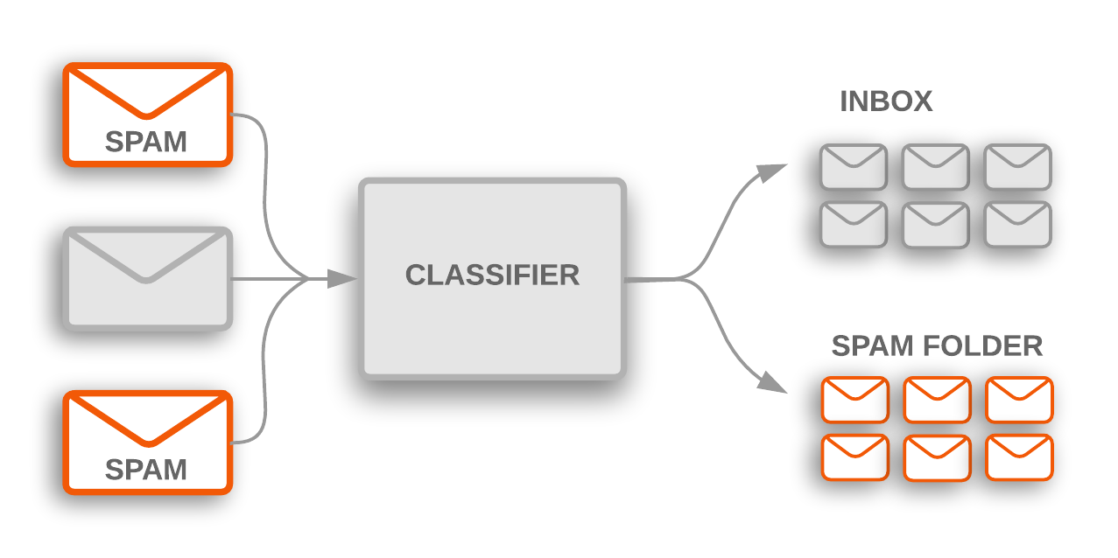
Building a Simple Text Classification Model
Creating a binary text classification model for distinguishing spam from non-spam emails:
In text classification, the goal is to categorize text documents into predefined classes or labels. A binary classification example involves sorting emails into two categories: spam and non-spam.

Slide 14
Building a Simple Text Classification Model
Steps:
Data Collection and Preprocessing:
Gather a dataset of emails that are labeled as spam or non-spam.
Preprocess the data, which includes tasks like text cleaning, lowercasing, and tokenization.
Split the data into training and testing sets to train and evaluate the model.
2) Feature Extraction:
Convert the text data into numerical features that can be used for modeling. Common techniques include Bag of Words (BoW) or TF-IDF.
Generate a feature matrix where rows represent emails, and columns represent features (e.g., word frequencies).
Example (BoW feature matrix):
 | word1 | word2 | ... | wordN
Email 1 | 2 | 0 | ... | 1
Email 2 | 0 | 3 | ... | 0
... | ... | ... | ... | ...
Email N | 1 | 0 | ... | 0

Slide 15
Building a Simple Text Classification Model
Steps:
3) Model Selection:
Choose a classification algorithm for the task. Common choices include:
Naive Bayes: Simple and effective for text classification.
Support Vector Machine (SVM): A powerful algorithm for binary classification.
Logistic Regression: Another popular choice for text classification.
Deep Learning (e.g., Neural Networks): For more complex tasks and large datasets.
4) Model Training and Evaluation:
Train the selected model using the training data.
Evaluate the model's performance using the testing data. Common evaluation metrics include accuracy, precision, recall, and F1-score.
Fine-tune the model parameters or try different algorithms to improve performance.

Slide 16
Hands-on: Text Preprocessing
For this exercise, we'll use the NLTK library to tokenize the text, perform text cleaning, and remove stop words.
Notes:
Note:- Use Jupyter file for this question - Text Preprocessing - NLP.ipynb

Slide 17
Hands-on: Text Classification
Building a simple NLP (Natural Language Processing) model for text classification using.
This model will classify text messages (email) as either "ham" (not spam) or "spam."
Notes:
Note:- Use Jupyter file for this question - Text Classification - Email (Spam-Ham).ipynb

Slide 18
Hands-on: Sentiment Analysis
Dataset: IMDB Movie Review
Notes:
Note:- Use Jupyter file for this question - Sentiment Analysis (NLP) - IMBD Movie Review.ipynb

Slide 19
Questions ?

Slide 20
Thank You !

